Slide 1
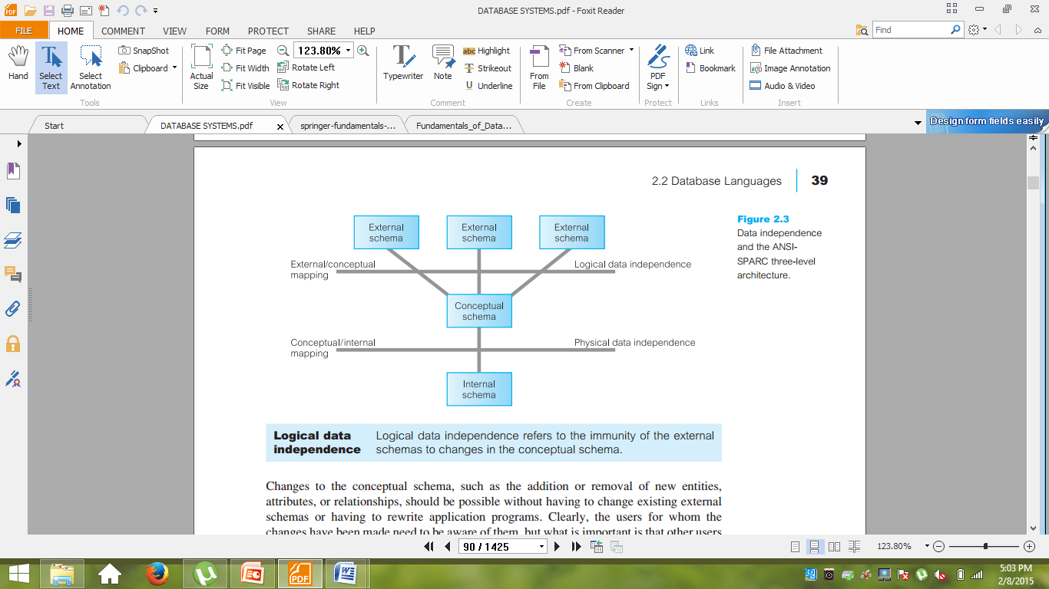
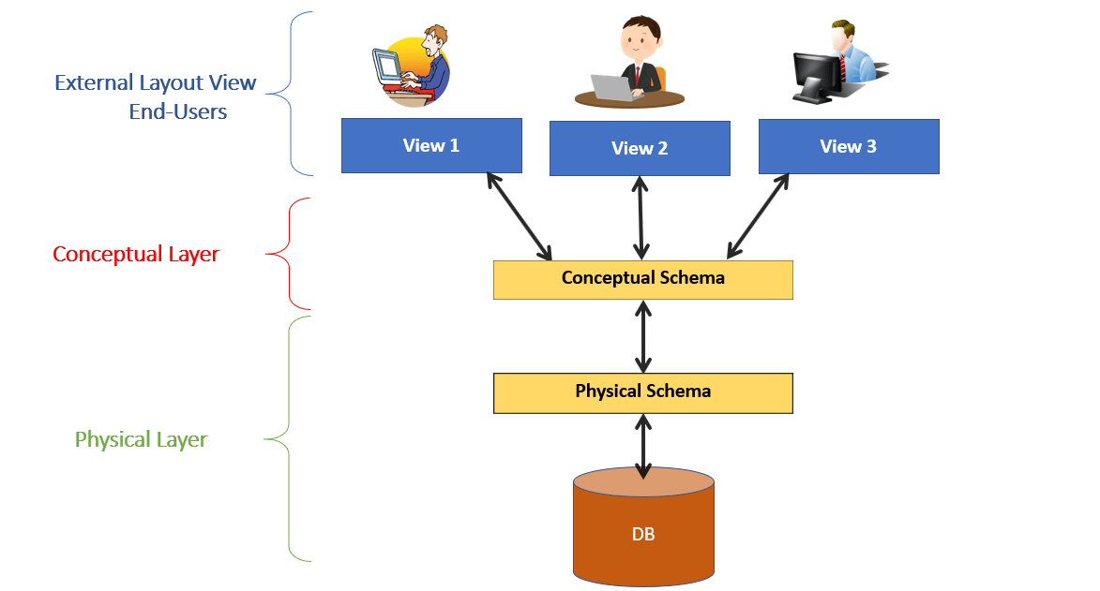
Data Independence
A major objective for the three-level architecture is to provide data independence, which means that upper levels are unaffected by changes to lower levels. There are two kinds of data independence:
    logical data independence
    physical data independence

Slide 2
Data Independence
Logical data Independence
Logical data independence refers to the immunity of the external independence schemas to changes in the conceptual schema
Changes to the conceptual schema, such as the addition or removal of new entities,
attributes, or relationships, should be possible without having to change existing external
schemas or having to rewrite application programs
The users for whom the changes have been made need to be aware of them, but what is important is that other users should not be.

Slide 3
Data Independence
Physical data independence
Physical data independence refers to the immunity of the conceptual independence schema to changes in the internal schema.
Changes to the internal schema, such as using different file organizations or storage structures, using different storage devices, modifying indexes, or hashing algorithms, should be possible without having to change the conceptual or external schemas
From the users’ point of view, the only effect that may be noticed is a change in performance

Slide 4
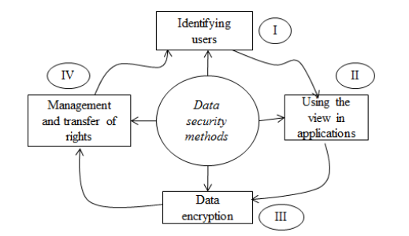
Database Security
Security – all the processes and mechanisms by which computer-based equipment, information and services are protected from unintended or unauthorized access, change or destruction

Slide 5
Terms
Database Authorization: It is a process when Database Manager gets information about authenticated user.
Database Authentication: It is a process of confirming that a user who is attempting to access/log in to a database is authorized to do so.
      Password Encryption While Connecting
      Account Locking
      Password Life and Expiration
      Password History
      Password Complexity Verification

Slide 6
Audit Trail: It is record showing who, when , what has accessed in a database.
There are three level that can be audited
    Statement Level auditing
    Object Level auditing
    Privilege Level auditing
Database Encryption
  With database encryption, an encryption algorithm transforms data within a database from a readable state into a ciphertext of unreadable characters. With a key generated by the algorithm, a user can decrypt the data and retrieve the usable information as needed
      Cell-Level
      Column-Level
      Tablespace-Level
      File-Level
Grant and Revoke privileges

Slide 7
Access Control
  Access Control
  Access control for a whole DBMS - account numbers and passwords
    login procedure, login session, database audit and audit trail
  Access control for portions of a database
    in a multiuse DBMS different users may be entitled access to different portions of the same DB

Slide 8
Discretionary Access Control
Based on granting and revoking privileges
Assign privileges
  account level (subject)
    independent of the relations
    create schema, create table, create view
  relation level (object)
    on a particular base relation or view

Slide 9
Access (authorization) matrix model
row - subject
column - object
M(i,j) -> read, write, update
for example M(a,B) = read means that subject a holds a read privilege on object B
Owner of the relation (typically the creator) is assigned the owner account for that relation and is given all privileges on that relation

Slide 10
Grant/Revoke
Grant the following privileges to other accounts (relation level) – system and object privileges
  Select
  Modify (update, delete, insert tuples)
  References (can reference the relation or specific attributes of the relation when specifying integrity constraints)

Slide 11
Grant SQL statement
Grant {privileges} on {table | view} to {user | public | role}
  Where privileges are:
    Select, alter, delete, update, index, references, insert, all
    Can specify list of (columns) after privileges only for insert, update
    Cannot specify list of columns for select privileges
  Grant select, delete on Employee, Department
  to rsmith

Slide 12
To access tables granted permission
User granted access to table must qualify name of that table with owner
    Select *
    from svrbsky.Employee
    where dno = 4

Slide 13
Grant/Revoke
Revoking privileges
Revoke {privilege} on {table | view} from {user | public | role}
  Revoke delete on Department from rsmith

Slide 14
Example of grant/revoke
Example: User1 issues
  Create table Employee(SSN, Fname, Lname, Salary)
User1 can issue the following statements:
  Grant select, update on Employee to Xiaoyan;
  Revoke update on Employee from Jeff;

Slide 15
Using views
Create view EMP5
as (select Fname, Lname
from Employee
where dno=5);
Grant select on EMP5 to Bob;

Slide 16
Rather than grant privileges to individual users, can grant them to groups using roles
Create role role_name
Grant {privilege} [on {table}] to role_name
Grant role_name to user

Slide 17
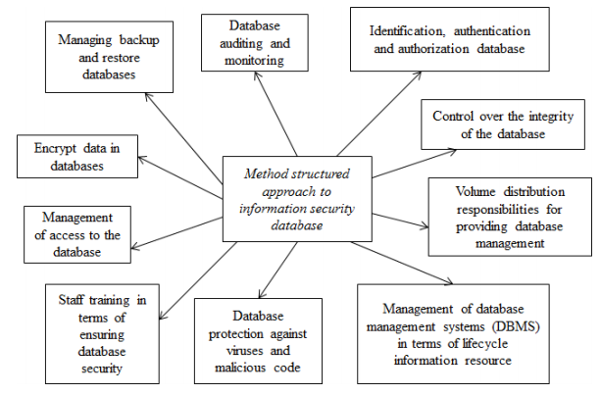
Structural Approach For Ensuring
Database Security

